Slide 1
OSG202 LAB 02
ASSIGNMENT REPORT
Using Basic Linux Commands
Student
ID
Class
Nguyễn Đăng Lộc
SE160199 SE1602

Slide 2
Table of contents
Using command line in Linux
03
File management
15
02

Slide 3
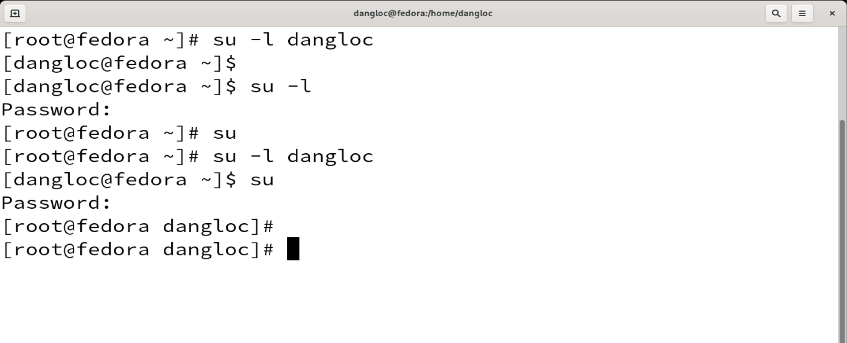
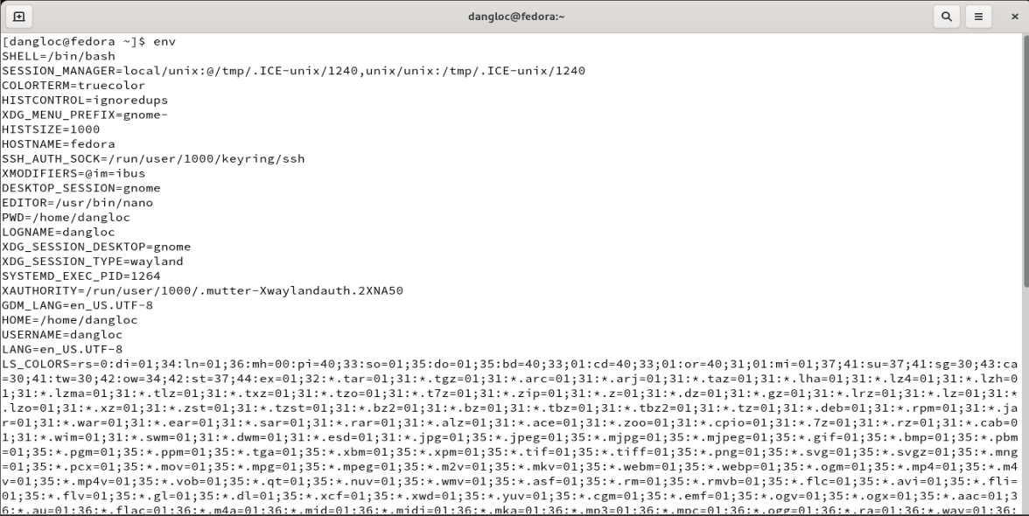
1. COMMAND LINE IN LINUX
1.1. Su
Syntax: su [OPTIONS]…[-]….[ USER [ARG…]]
Description: allows commands to be run with a substitute user and group ID
Example:
1.2. Env
Syntax: env [OPTION]… [-] [NAME=VALUE… [COMMAND [ARG]…]
Description: set each NAME to VALUE in the envitonment and after that
run COMMAND
Example:
Display all the environment variables with the comman ‘ENV’ (no arg)
03

Slide 4
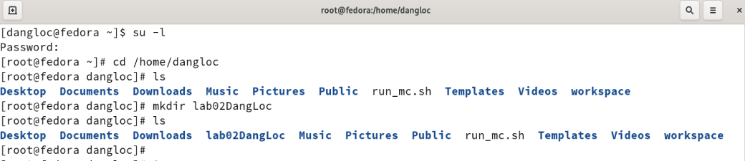
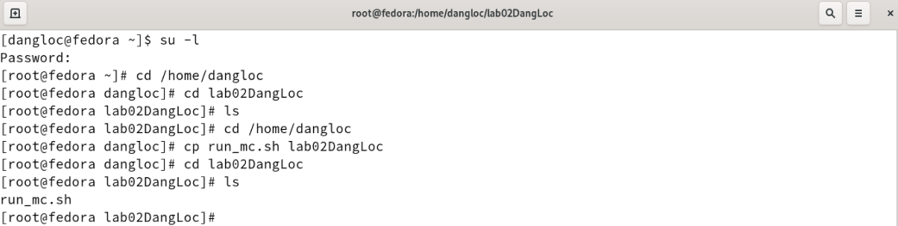
1.3. mkdir
Syntax: mkdir [OPTIONS]… DIRECTORY…
Description: Create the DIRECTORYq(ies), if they do not already exist
Example:
Folder ‘lab02DangLoc’ was created in /home/dangloc
1.4. cp
Syntax:
cp [OPTION]… [-T] SOURCE DEST
cp [OPTION]… SOURCE… DIRECTORY
cp [OPTION]… -t DIRECTORY SOURCE…
Description: Copy SOURCE to DEST, or multiple SOURCE(s) to DIRECTORY
Example:
File ‘run_mc.sh’ was copied from dangloc to its subfolder lab02DangLoc
04

Slide 5
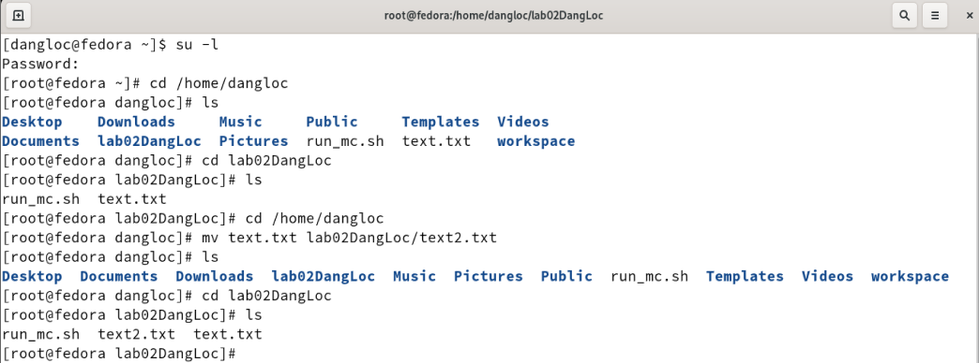
1.5. mv
Syntax:
mv [OPTION]… [-T] SOURCE DEST
mv [OPTION]… SOURCE… DIRECTORY
mv [OPTION]… -t DIRECTORY SOURCE
Description: rename SOURCE to DEST, or move SOURCE(s) to DIRECTORY
Example:
There is 2 file has the same name ‘text.txt’ in both /home/dangloc and /home/dangloc/lab02DangLoc
‘mv’ command moved the ‘text.txt’ file from dangloc to lab02DangLoc and renamed it to ‘text2.txt’
Now, the folder lab02DangLoc contain ‘text.txt’ and ‘text2.txt’ simultanously
05

Slide 6
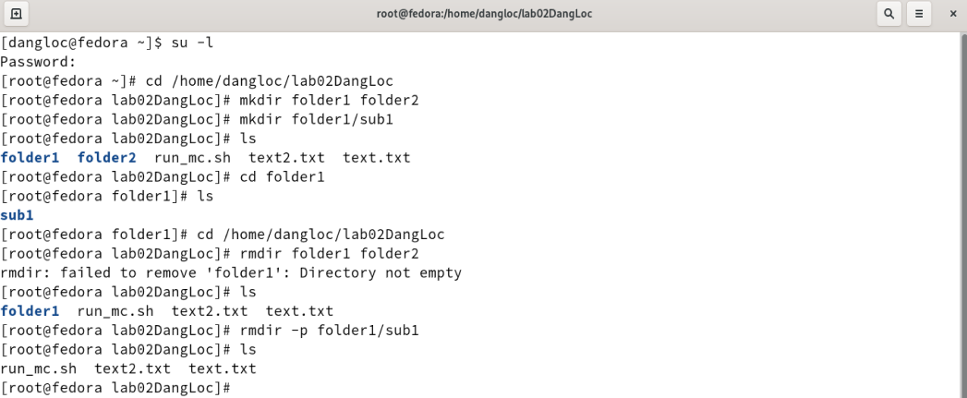
1.6. rmdir
Syntax:
mrdir [OPTION]… DIRECTORY
Description: remove the DIRECTORY(ies), if they are empty
Example:
There are 3 subfolders in lab02DangLoc: folder1, folder2, folder3
The folder1 contains ancestors. Hence, if we want to delete the entire folder1, we have to use option ‘-p’ – remove directory and its ancestors.
If the command miss the ‘-p’, it will display an error message and the folder won’t be removed.
06

Slide 7
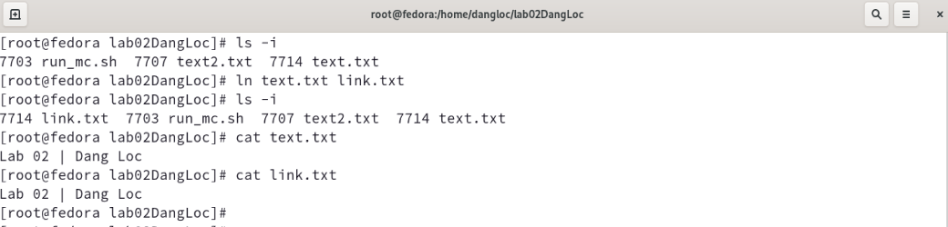
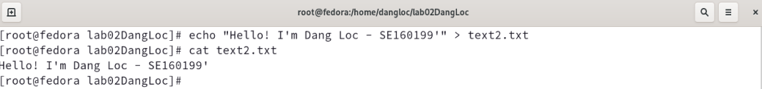
1.7. ln
Syntax:
ln [OPTION]… [-T] TARGET LINK_NAME
1st form
2nd form
ln [OPTION]… TARGET
3rd form
ln [OPTION]… TARGET… DIRECTORY
4th form
ln [OPTION]… -t DIRECTORY TARGET…
Description:
1st form: create a link to TARGET with the name LINK_NAME.
2nd for:, create a link to TARGET in the current directory.
3rd, 4th forms: create links to each TARGET in DIRECTORY.
Example:
A softlink was created between ‘text.txt’ and ‘link.txt’
1.8. cat
Syntax:
cat [OPTION]… [FILE]…
Description: Concatenate FILE(s), or standard input, to standard output
Example:
The content inside file ‘text2.txt’ is displayed
07

Slide 8
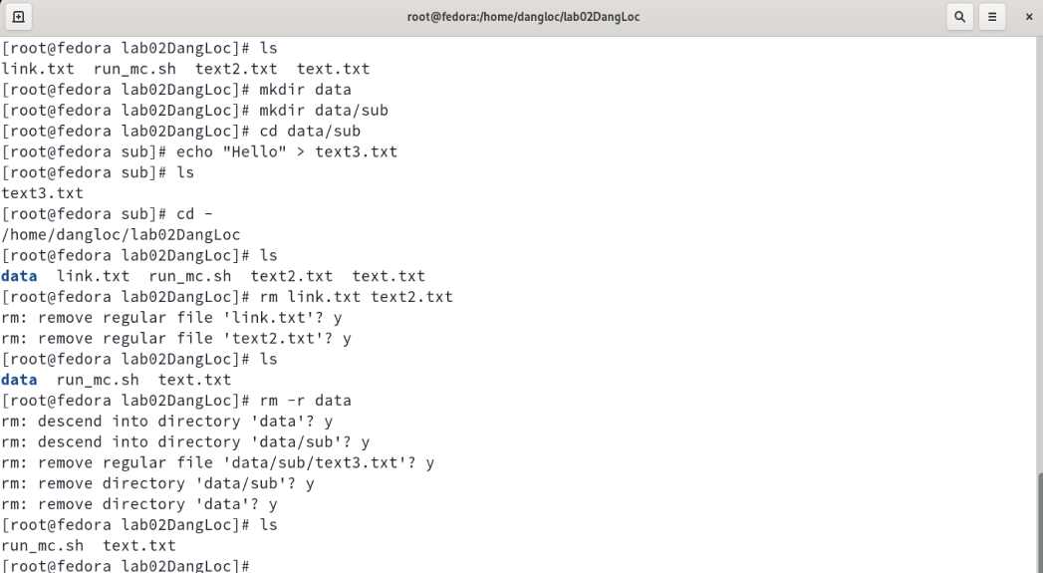
1.9. rm
Syntax:
rm [OPTION]… FILE…
Description: Remove files or directories (with their contents recursively)
Example:
Remove file ‘link.txt’ and ‘text2.txt’.
To remove folder ‘data’ and its contents, I use option ‘-r’ – remove directories and their contents recursively.
Confirm by press ‘y’.
08

Slide 9
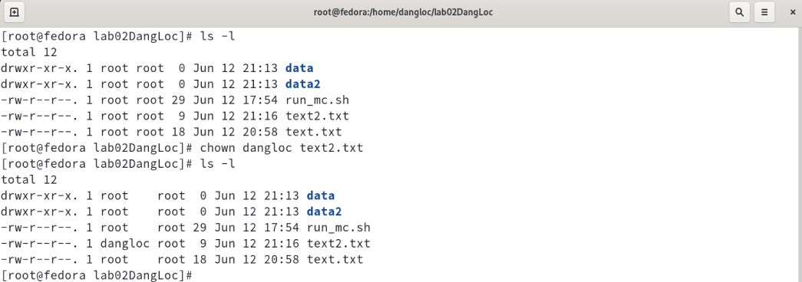
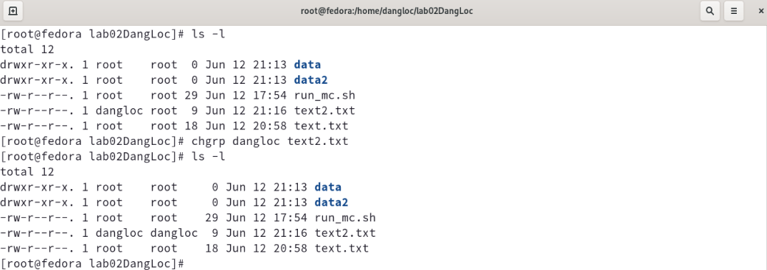
1.10. chown
Syntax:
chown [OPTION]…[OWNER] [:[GROUP]] FILE…
chown [OPTION]… --reference=RFILE FILE…
Description: Change files owner and group
Example:
The owner of file ‘text2.txt’ was change from ‘root’ to ‘dangloc’.
1.11. chgrp
Syntax:
chgrp [OPTION]… GROUP FILE…
chgrp [OPTION]… --reference=RFILE FILE…
Description: Change the group of each FILE to GROUP. With –reference, change the group of each FILE to that of RFILE.
Example:
The group ownership of ‘text2.txt’ was change from ‘root’ to ‘dangloc’.
09

Slide 10
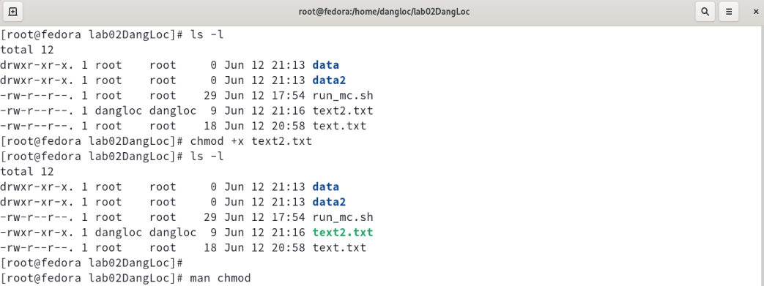
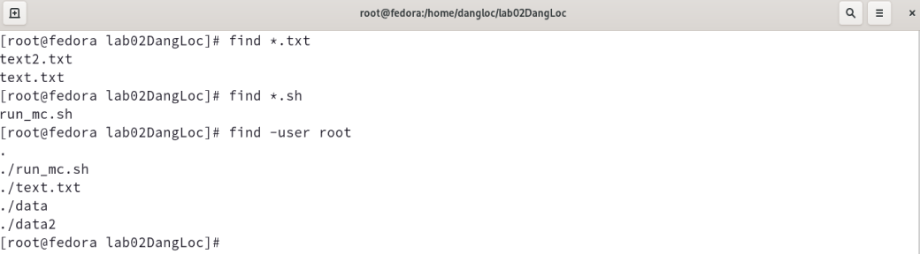
1.12. chmod
Syntax:
chmod [OPTION]… MODE[ ,MODE]… FILE…
chmod [OPTION]… OCTAL-MODE FILE…
chmod [OPTION]… --reference=RFILE FILE…
Description: Change file mode bits
Example:
Adding the permission to execute the file ‘text2.txt’
1.13. find
Syntax:
find [-H] [-L] [-P] [-D debugopts] [-0level] [path…] [expression]
Description: Search for files in a directory hierarchy
Example:
Find files: This case, I want to find text file then using format ‘*.txt’
Find files/folder with user owner of root
10

Slide 11
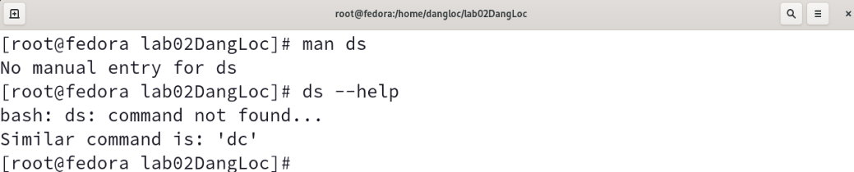
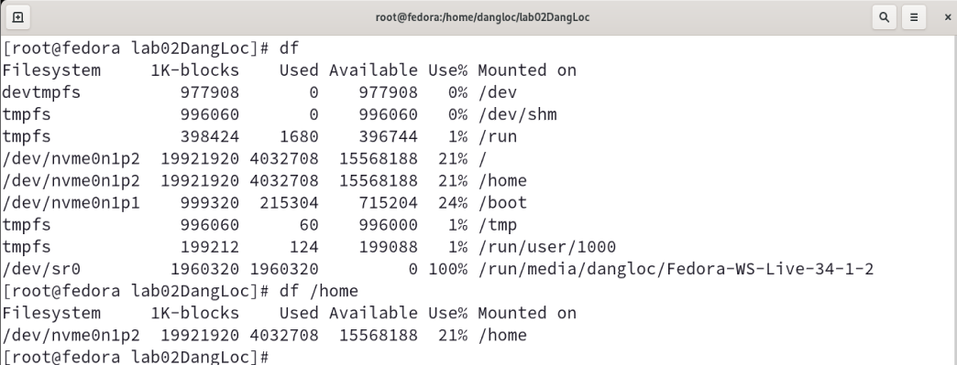
1.14. ds
I cannot find such a command.
1.15. df
Syntax:
df [OPTION]… [FILE]…
Description: Report file system disk space usage
Example:
11

Slide 12
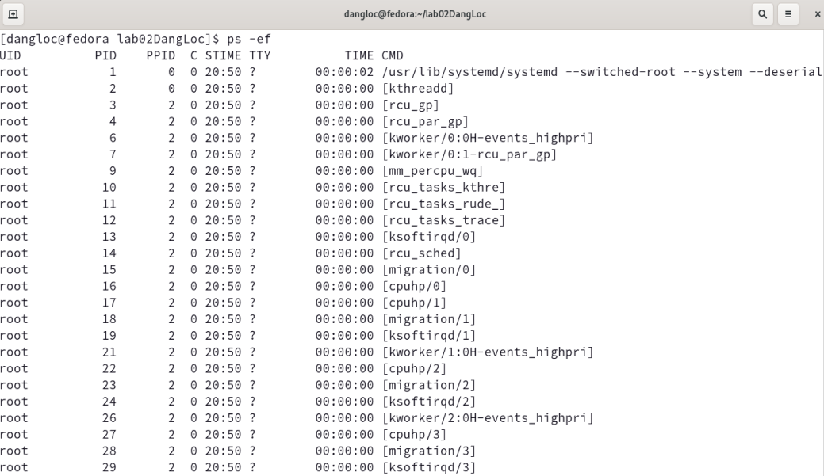
1.16. ps
Syntax:
ps [OPTION]
Description: Report a snapshot of the current processes.
Example:
12

Slide 13
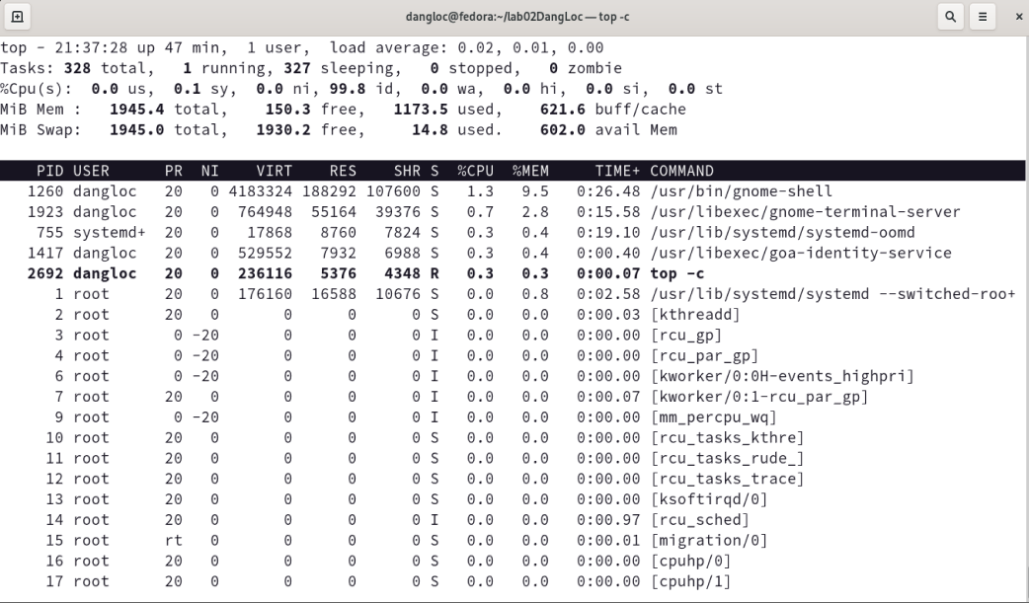
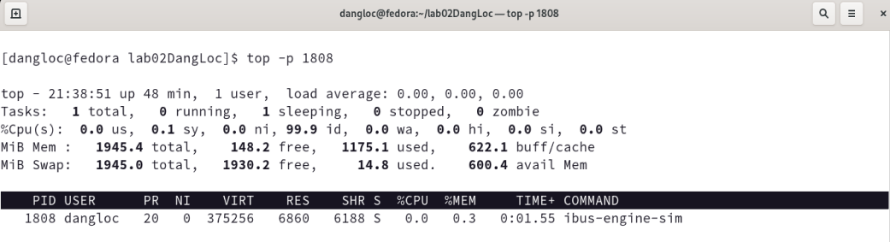
1.17. top
Syntax:
top –hv | -abcHimMsS –d delay –n iterations –p pid [, pid …]
Description: Display Linux tasks.
Example:
Command line: ‘top –c’
Command line: ‘top –p 1808’
13

Slide 14
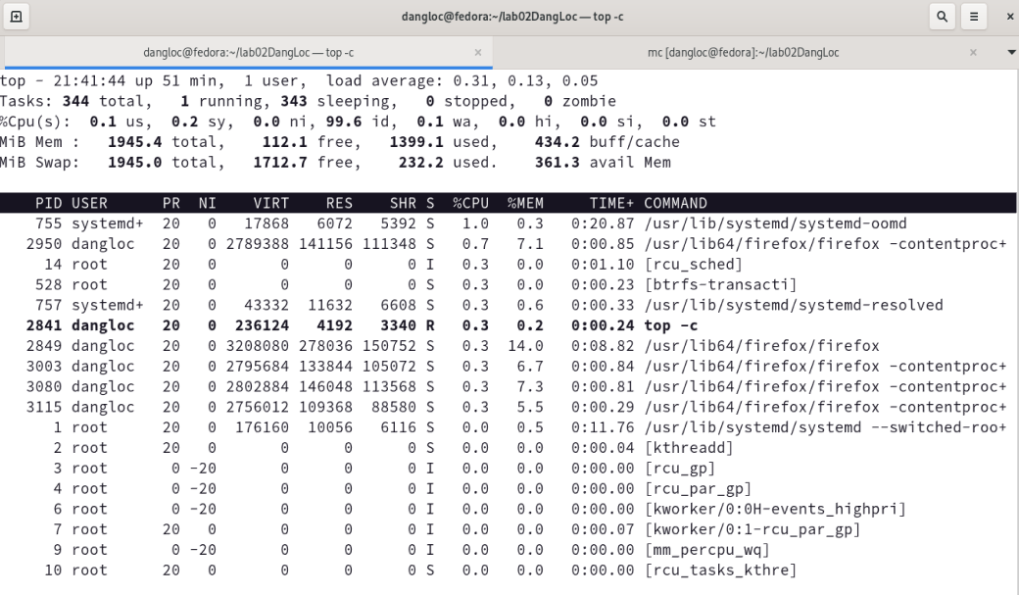
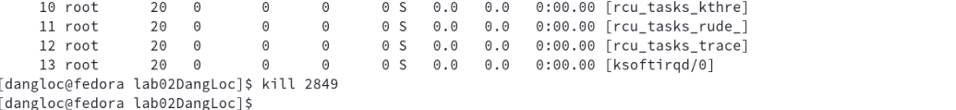
1.18. kill
Syntax:
kill [-s signal | -p] [--] pid…
kill –l [signal]
Description: Display Linux tasks.
Example:
The process ID 2849 of the Firefox is nơ running.
Kill it by the command line: kill 2849
04

Slide 15
1.19. jobs
Syntax:
jobs [-lnprs] [ jobspec …]
jobs –x command [ args …]
Description: List the active jobs.
Example:
14

Slide 16
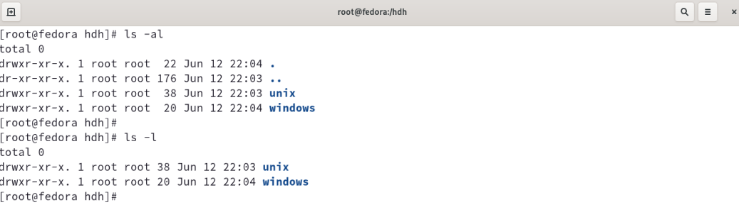
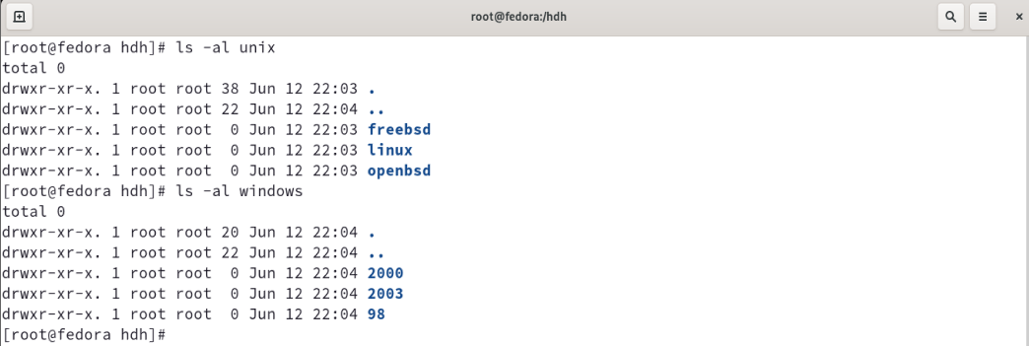
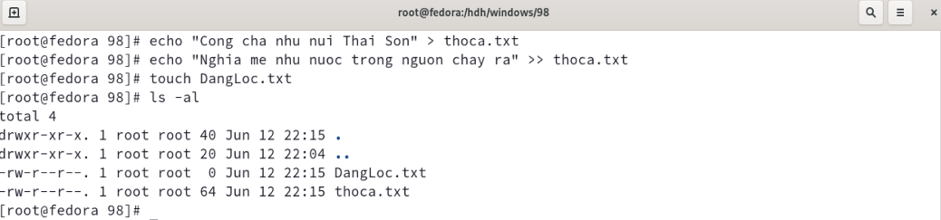
2. File management
The ‘hdh’ folder contain 2 subfolders:
+ unix
+ windows
The ‘unix’ folder contain 3 subfolders inside: freebsd, linux, openbsd
The ‘windows’ folder contain 3 subfolders inside: 98, 2000, 2003
Create 2 text file in /hdh/windows/98:
+ The file ‘thoca.txt’ has contents inside.
+ The file ‘DangLoc.txt’ is an empty text file.
15

Slide 17
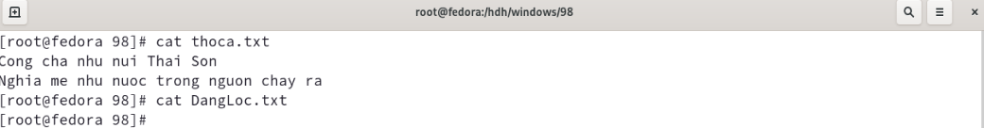
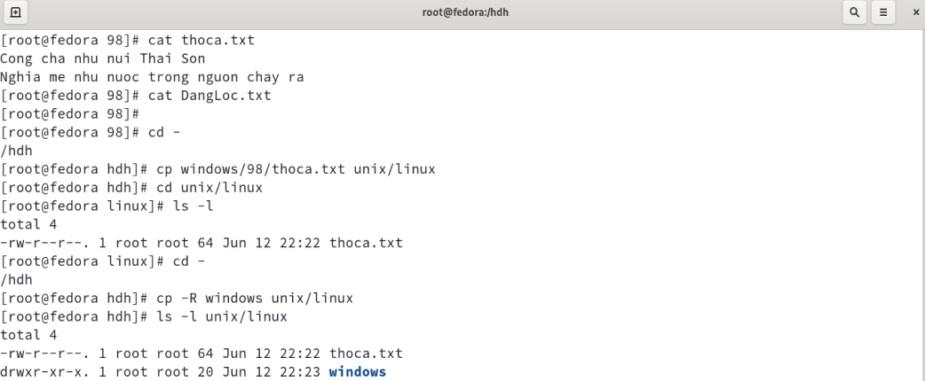
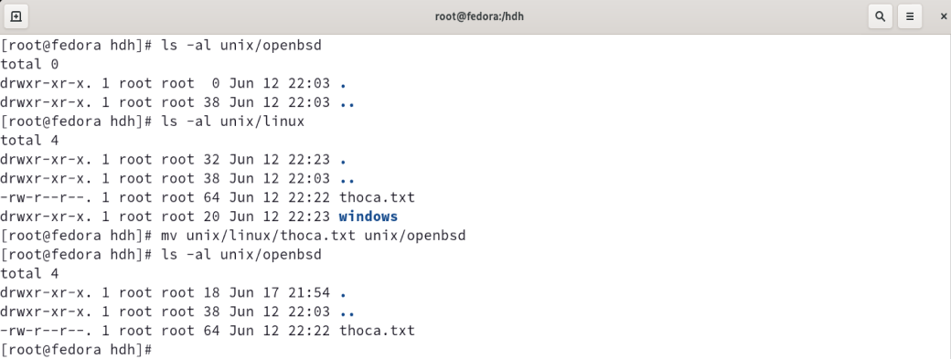
View contents in ‘thoca.txt’ and ‘DangLoc.txt’
Copy file and folder to Linux folder
Move the file thoca.txt from linux to openbsd
16

Slide 18
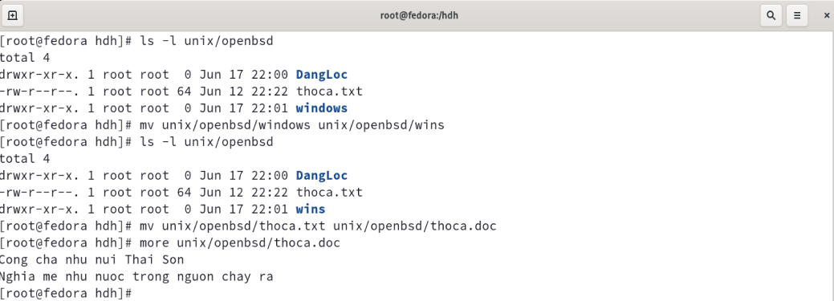
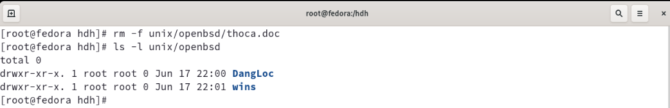
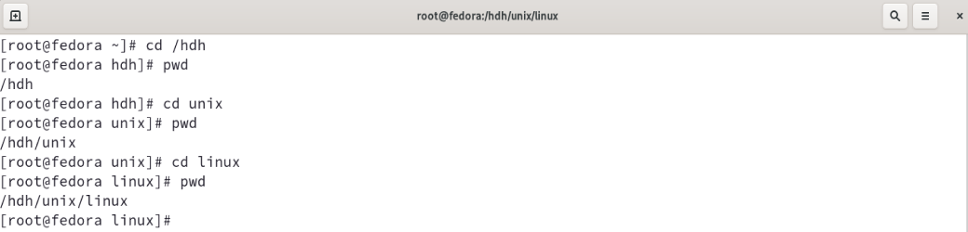
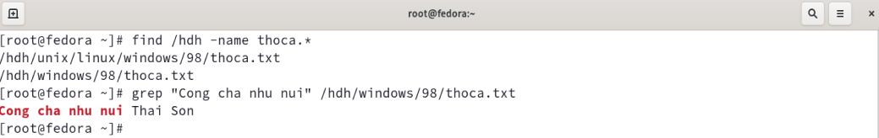
Rename file and directory: windows -> wins
Delete file thoca.doc in openbsd directory
Move the file thoca.txt from linux to openbsd
Sereaching find thoca.txt and “Cong cha nhu nui” in the text file
17

Slide 19
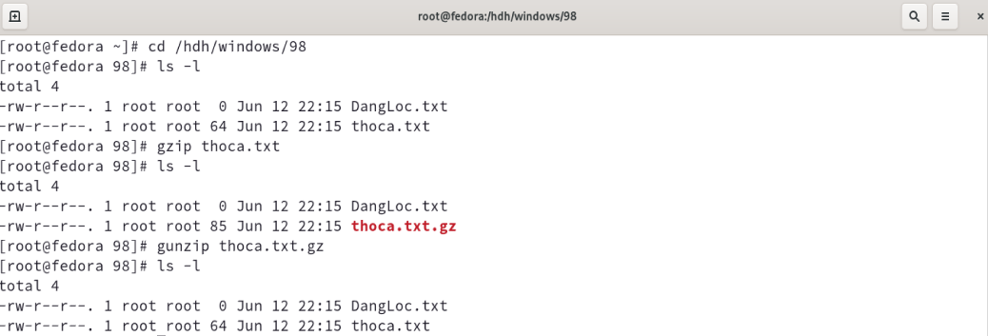
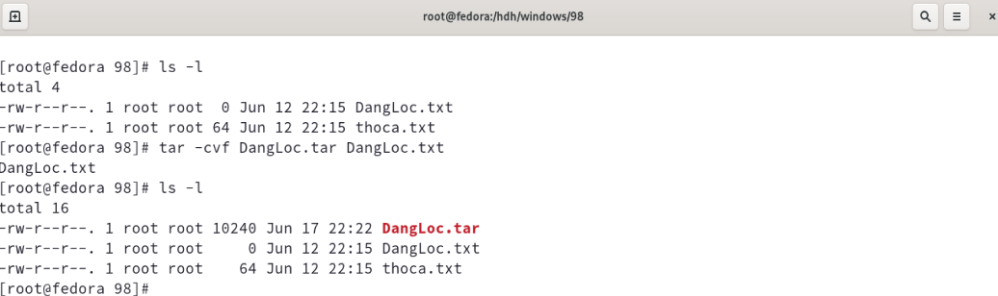
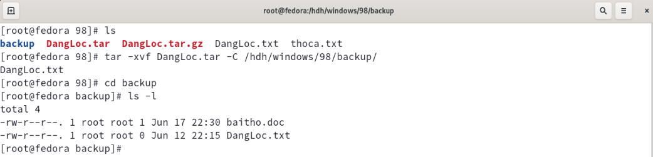
Zip the file thoca.txt using gzip, then unzip by gunzi
Zip the file thoca.txt using tar
18

Slide 20
Thank you!
By Nguyen Dang Loc

